Slide 1

Team OTAVA
Group 32

Slide 2
Team Members
Ojjas Tyagi, CS20BTECH11060
Tanmay Garg, CS20BTECH11063
Anirudh Srinivasan, CS20BTECH11059
Vikhyath Sai Kothamasu, CS20BTECH11056
Aman Panwar, CS20BTECH11004

Slide 3
Introduction
Our Project is an orrery i.e., a working, interactive solar system model of all the planets up to Saturn.
It functions using an intricate gear system which ensures that the time periods of the planets are as similar as possible to their real-life counterparts.
The mechanism of the gears dictate how fast each planet should move to simulate the actual time for each planet to revolve around the Sun
Along with mechanical parts there are very interesting designs on every part of the project as well as detailing for planets
In order to make a proper working model we have made planets up to Saturn as the radii of the gears for further planets were becoming very large in size

Slide 4
Origin
Some of us were interested in Solar System and Astronomy, so we searched on the internet for models of Solar System
The physical mechanical model of Solar System is called Orrery
We watched a video and were really inspired by it and so we modelled a Solar System similar to the video

Slide 5
About the Project
The model consists of a total of 46 parts which are as follows:
20 gears: responsible for timing and movement
4 idler arms: arms for idler gears which connect the gear-train
6 planet arms: support and rotate planets
6 planets: detailed models of celestial bodies
Calendar disk: Shows the month’s, acts as idler as well
6 Pegs,1 Main axle,1 idler axle and 1 Sun.

Slide 6
Novelty, Challenge and Application
This Project can be used for teaching students about the solar system and to help them visualize the motion of the planets
To Create Gears all the gear ratios and radii of gears and dimensions of idlers and arms were calculated using Gear Theory, Rigid Body Dynamics and Planetary Time Periods
High Printing time(~19Hr)

Slide 7
Contributions
Gear Design Team – Tanmay and Aman
Planet Modeling – Anirudh
Arms and Idlers- Vikhyath and Ojjas
Assembly File and Print - Tanmay

Slide 8
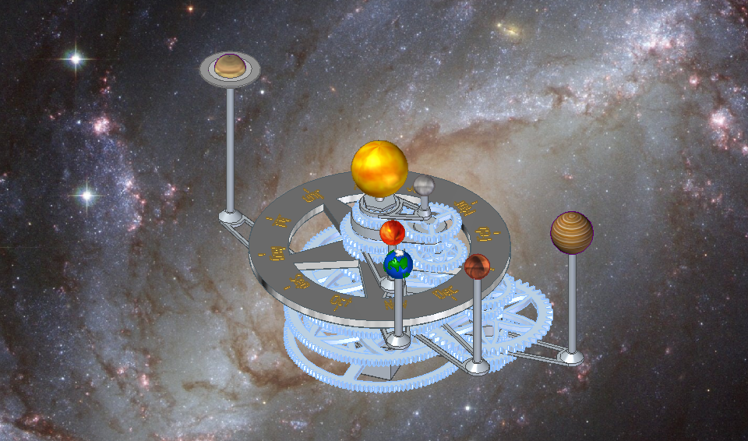
Project Assembly

Slide 9
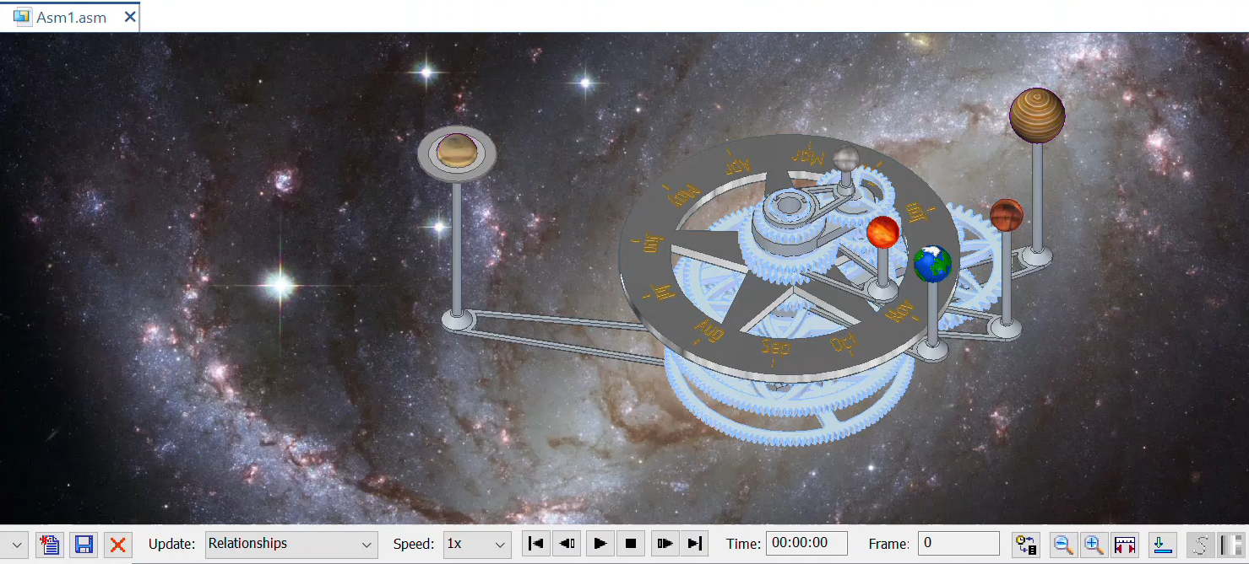
Project Assembly

